Slide 1





Coastal Hazards and Risk Analysis
ESCAP/WMO Typhoon Committee
18th Integrated Workshop / 4th TRCG Forum
ESCAP Conference Center, Bangkok, Thailand
“Early Warnings for All Through Enhancement of Typhoon Standard Operating Procedures (SOP)”
&
" Towards a Typhoon Resilient Society "
Nadao Kohno
The Third Laboratory,
Department of Applied Meteorology Research,
Meteorological Research Institute, JMA
nkohno@mri-jma.go.jp; nkono@met.kishou.go.jp

Slide 2

Overview
Introduction
  Marine (storm surge) disasters
  Risk of storm surges
How to analyze marine hazard risks
  Numerical Models / Systems
  Product / Information for DRR
Enhancement of information services
  Linkage of regional frameworks

Slide 3
Historical deadliest storm surge cases
year | cause | Total death | Total damage (Million US$) | Country
1970 | (Bhola) | 300,000 | 86.4 (651.3) | East Pakistan (Bangladesh)
1991 |  | 138,866 | 1,780 (3,824.9) | Bangladesh
2008 | Nargis | 138,366 | 4,000 (5,437.1) | Myanmar
1965 |  | 36,000 | 57.7 (535.9) | Bangladesh (East Pakistan)
1963 |  | 22,000 | 50 (477.8) | Bangladesh (East Pakistan)
1985 |  | 15,000 | 50 (136.0) | Bangladesh
1977 |  | 14,204 | 498.5 (2,407.2) | India
1965 |  | 12,047 |  | Bangladesh (East Pakistan)
1999 | 05B | 9,843 | 2,500 (4,392.2) | India
2013 | Haiyan | 7,354 | 10,000 (12,562.6) | Philippines
1959 | Vera | 5,098 | 600 (6,023.8) | Japan
2007 | Sidr | 4,234 | 2,300 (3,246.4) | Bangladesh
1953 |  | 2,000 | 300 (3,274.2) | Nederland
2005 | Katrina | 1,833 | 125,000 (187,319.1) | USA
Source: EM-DAT (https://public.emdat.be/)

Slide 4
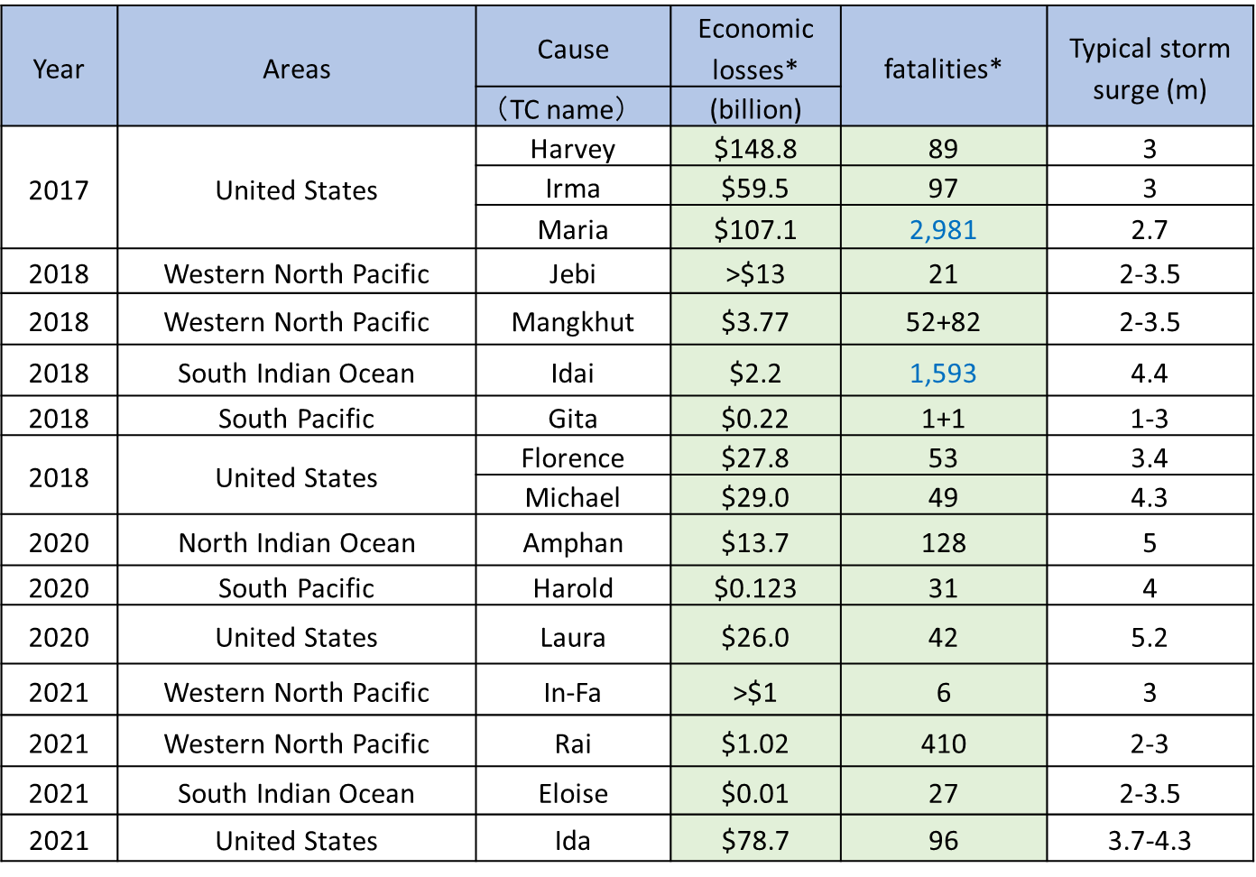
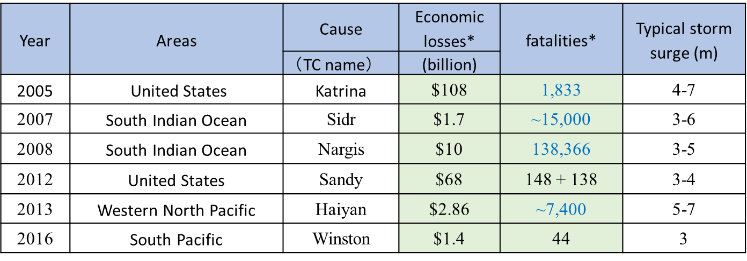
Recent major storm surge cases generated by TCs
Total deaths (not only deaths from storm surge).
U.S. economic losses referenced from: https://www.ncei.noaa.gov/ . For U.S., fatalities and storm surge are specific to U.S. and referenced from NHC Tropical Cyclone Reports: https://www.nhc.noaa.gov/data/tcr/index.php
Notes:
Ensure images are legible

Slide 5
Storm surges…
They are capable of causing significant disasters:
killing more than thousands of people at once
damaging infrastructure critically.
Studies have shown that nearly half of direct fatalities in US are attributed to storm surge (Rappaport 2014).
While storm surges have devastated many parts of the world, the death toll is remarkably decreased in recent cases (< 100) although economic losses are sometimes huge.
This would be partly come from improved warning services on coastal hazards.
Storm surge is one of the key hazards associated with tropical cyclones, although severe storm surge disaster does not happen so frequently.

Slide 6
Definition of storm surges
Abnormal rise of sea level caused by meteorological phenomena (typhoons, hurricanes, cyclones, extra-tropical cyclones).
Sea level changes are caused by strong winds and pressure depressions.
From a hydro-dynamical point of view, storm surges are classified to external gravity waves, especially shallow water waves (long waves) as their large horizontal scale, as well as tsunamis.
Strictly speaking, storm surges are defined as the anomaly from the usual sea levels (= observed water level - astronomical tide).
However, the term “storm surge” is widely used for just expressing the phenomenon itself.

Slide 7
Risk of Storm Surges
land
water
(definitely) Safe
Safe
(still) Safe
danger
Very danger
Risk of storm surges is decided by the difference
Between water level and land height.

Slide 8
Main mechanism of storm surges
1. Inverse barometer effect
1hPa pressure decrease ≒ 1cm surge
2. Wind setup
surge
∝τ_{s} (V²) (wind stress: square of wind speed)
∝L (horizontal scale of wind: fetch)
∝1/h (inverse of water depth)
 | Inverse barometer effect | Wind setup | (Wave setup)
Large shallow basin | ○ | ◎ | ×
Steep bottom sea, solitary islands | ○ | × | ○
Offshore | ○ | × | ×

Slide 9
Key mechanisms of storm surges
1. Inverse barometer effect
1hPa pressure decrease ≒ 1cm surge
2. Wind setup
surge
∝τ_{s} (V²) (wind stress: square of wind speed)
∝L (horizontal scale of wind: fetch)
∝1/h (inverse of water depth)
 | Inverse barometer effect | Wind setup | Wave setup
Large shallow basin | ○ | ◎ | ×
Steep bottom sea, solitary islands | ○ | × | ○
Offshore | ○ | × | ×

Slide 10
Other factors to be considered
To access marine hazard risks, the following factors should be considered, although the necessities of them much varies among local conditions.
Astronomical tide
Ocean waves (wave setup/runup)
River flows (floods)
Oceanographic condition
Sea Ice interactions
However, it is important to note that storm surges (and related phenomena) are dependent on typhoon conditions, and accuracy of typhoon condition is placed as the first priority.

Slide 11
Flow of storm surge information
TC conditions
Analysis/ forecast
Storm surge forecast
Risk assessment
Information
Warning/advisory
We need to consider the following matters in each step!
Accurate analysis?
Reliable forecast?
Detailed contents?
Accurate model?
Detailed conditions can be resolved?
Necessary factors are included?
Operationally useful?
(fast, sturdy)
Can we deal with TC forecast errors?
(Ensemble prediction)
Clear meaning?
Practically efficient?
Instructive?

Slide 12
Storm surge models
There are many storm surge models used in NMHSs. “Community ocean models” have become increasingly popular and often used in storm surge forecasts in the last decade.
Most of those models are regular-mesh finite difference models (Dube et al., 2009). Recently, unstructured numerical storm surge models have been used too, especially in research communities.
Ocean wave models are also available and a recent trend is to develop a surge - (tide) - wave coupled system. The results were very reasonable in terms of both storm surge and wave prediction.
Wave setup is a rather small scale phenomenon but such a high resolution (~ 50m) models have the ability to simulate the effect accurately.
The problem is that wave models need much computational resources than storm surge model, and such coupled models are not handy.

Slide 13
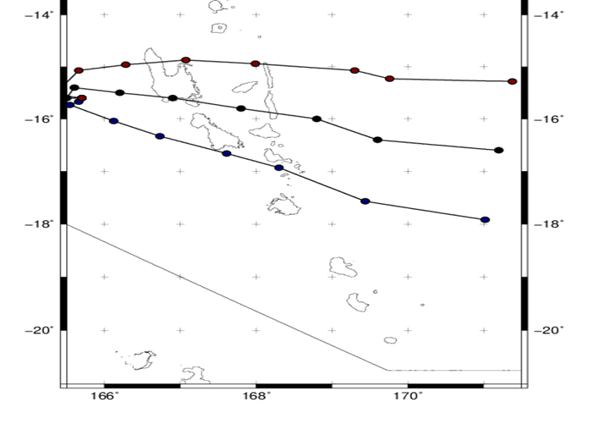
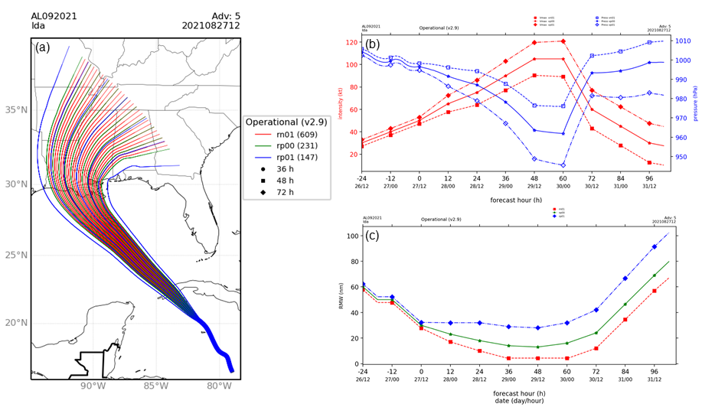
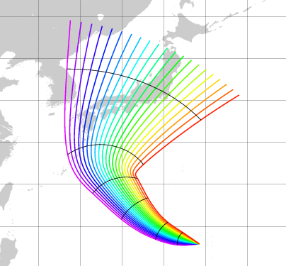
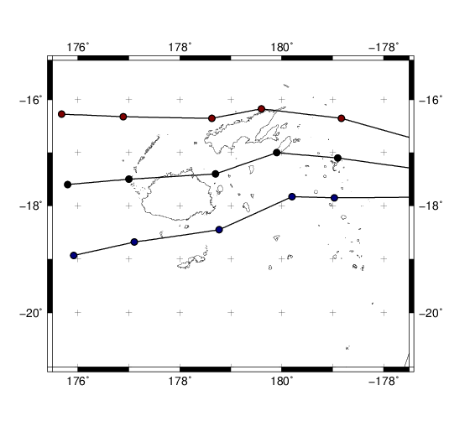
Dealing with forecast uncertainty
Storm surges are strongly dependent on the landfall location / intensity of TCs. Therefore, accurate TC forecasts is essential, but it is impossible to remove forecast errors in real.
Probabilistic (or multi-scenario) forecasts rather than deterministic is introduced in regions (US NHC, JMA, BoM and MSC. planned: FMS and IMD)
Considered conditions: US NHC & ECCC: track and intensity, JMA, BoM (and FMS): track
(d)
21cases
FT=120
FT=96
FT=72
FT=48
FT=24
An example of (a) the distribution of P-Surge ensemble track members, the three members of (b) intensity, and (c) size of NHC.
(d) the 21-track ensemble produced by JMA
Planned multi-scenario cases at FMS
Notes:
Ensure images are legible

Slide 14
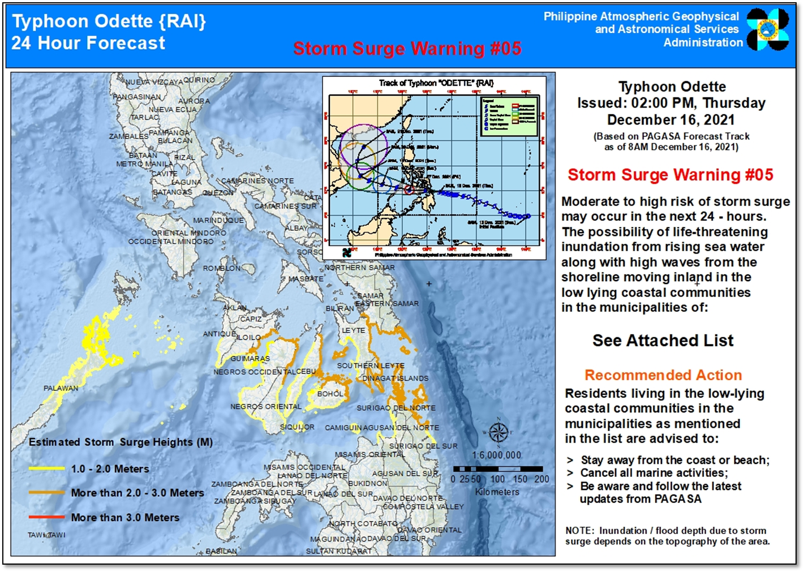
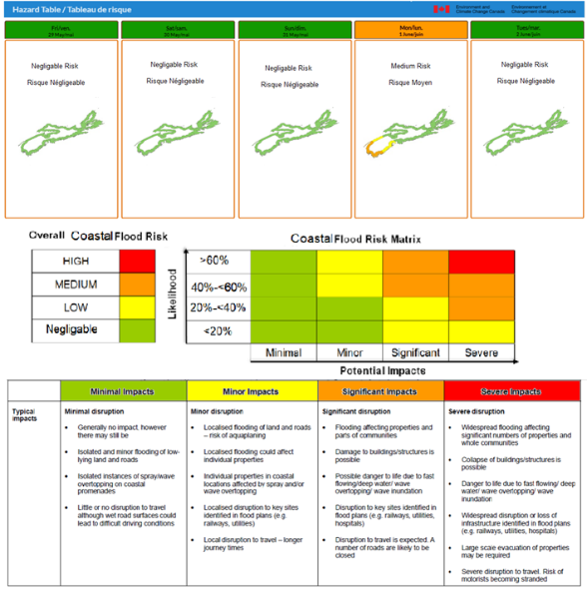
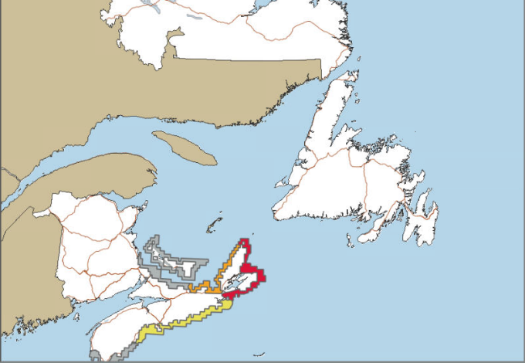
Information on area of coastal hazard
NHMSs have been indicating coastal hazard risk with map images.
Philippine Atmospheric Geophysical and Astronomical Service Administration (PAGASA) and Meteorological Service of Canada (MSC) issue maps indicating areas where coastal hazard is feared.
.
Coastal Flooding Risk issued from MSC
24-hour forecast (left) and 5 day outlook (right)
Risk maps of Storm Surge Warning issued from PAGASA
※Storm Surge(=total water level): surge (anomaly) + astronomical tide + wave setup
Notes:
Ensure images are legible

Slide 15
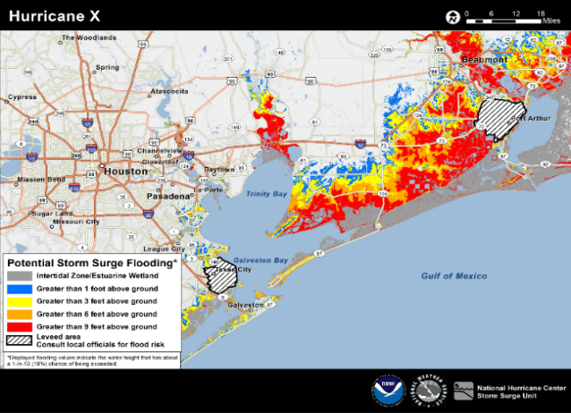
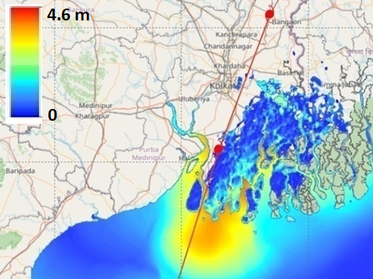
Inundation risk maps
Storm surge is an unfamiliar phenomenon and many people do not perceive the risk easily. Recently, the information issued from NHMSs have been shifting to indicate real risk, considering total water levels for evaluating inundation risks. US NHC and IMD (INCOIS) issue inundation risk maps (real time hazard maps).
An example of the Potential Storm Surge Flooding Map. Represents the storm surge heights at the 10% probability of exceedance
(NHC)
Forecasted storm surges and inundation heights due to Cyclone Amphan in May 2020
(IMD).
Detailed inundation heights (m) analyzed by the prototype system of the Strategic Innovation Promotion (SIP) Program of Japan
Notes:
Ensure images are legible

Slide 16
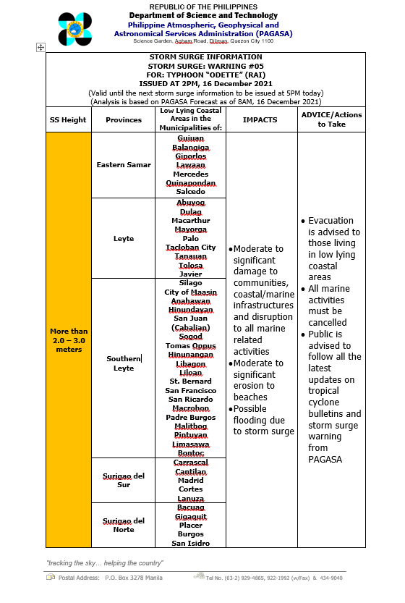
Explanation on Coastal Hazard Impact
Recently, possible coastal impacts are come to be informed to public with concrete disasters and adequate actions.
PAGASA issues impact and necessary actions in table form.
Notes:
Ensure images are legible

Slide 17
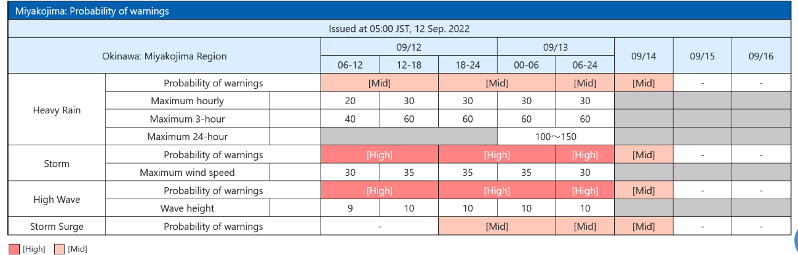
  Information based on requirement
Alerting the public (via Storm Surge Warnings) and providing impact-based information is necessary to mitigate loss of life and property. Regions have utilized a variety of alerting protocols to disseminate information more effectively, based on requirement of disaster authorities.
5-day perspective (probability of warning)
Specific storm surge guidance for local government
BoM basically provides 'worst case scenario’ storm tide, which is determined with worst case scenario storm surge + high tide.
In Queensland and the Northern Territory, guidance with “most likely” scenario is also provided to emergency managers, for interpretating error range.
The probability of warning for hazards over a 5-day period produced by JMA. The probability of storm surge warning is indicated qualitatively by “high” or “middle”.
Notes:
Ensure images are legible

Slide 18
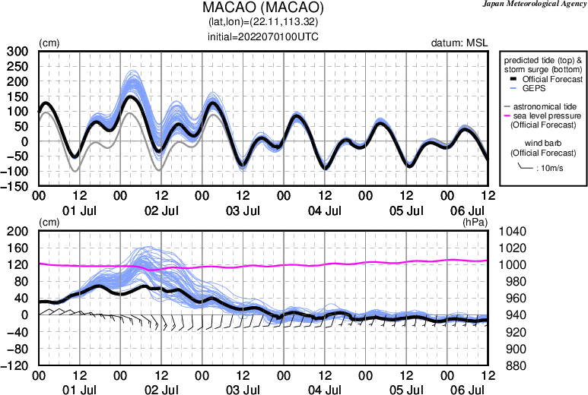
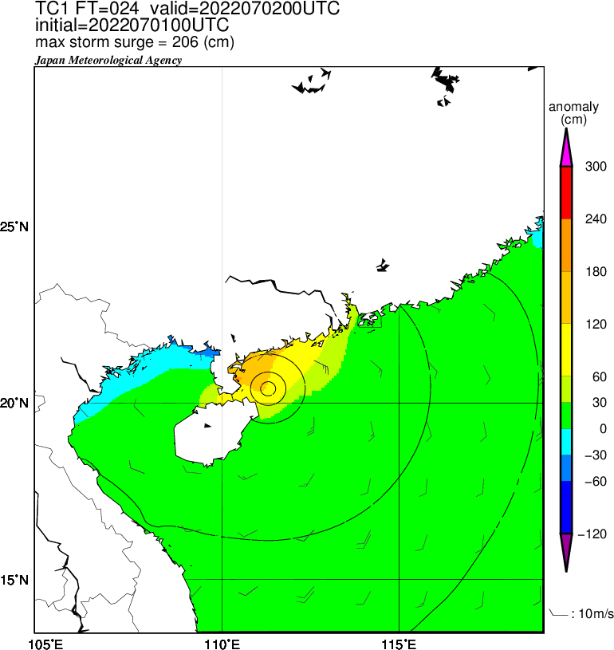
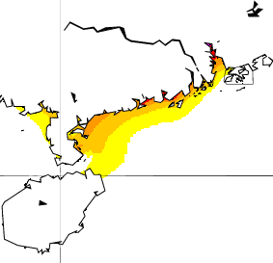
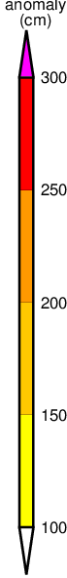
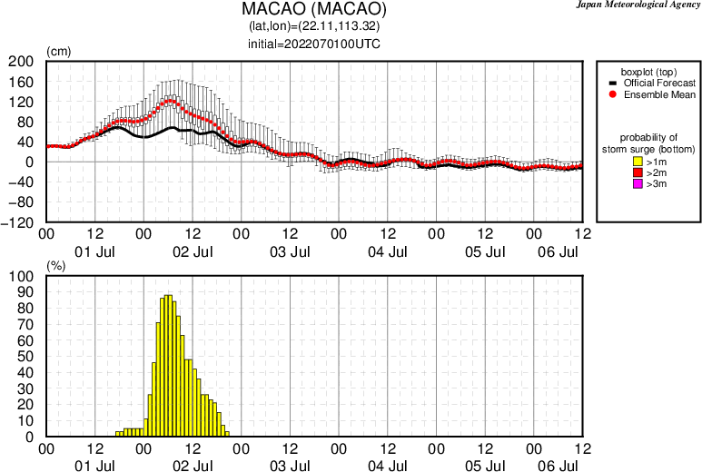
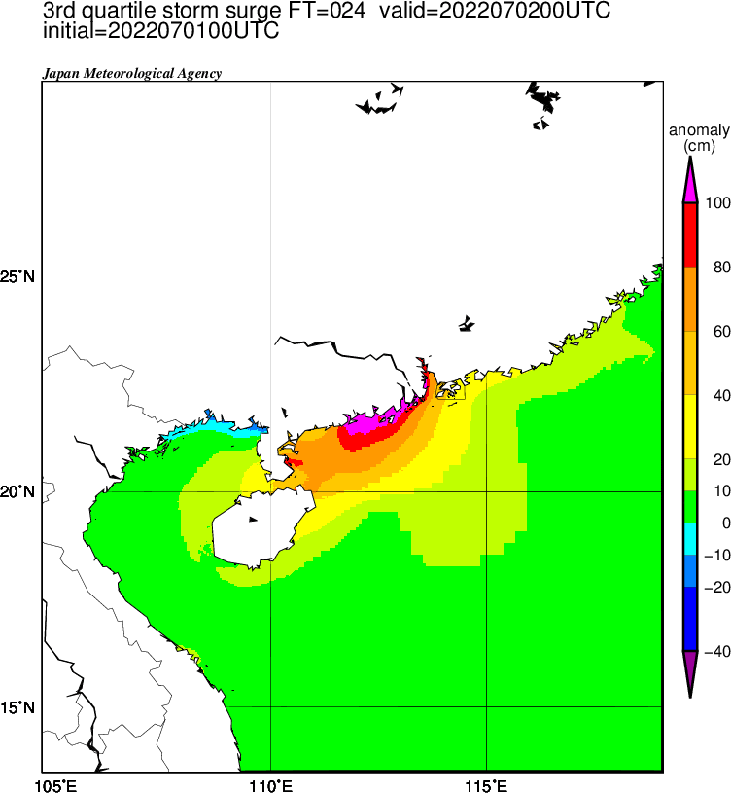
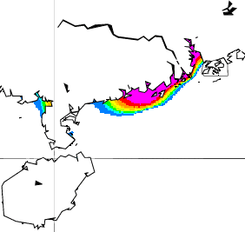
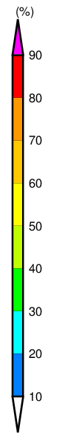
WMO Storm Surge Watch Scheme (SSWS)
Real-time storm surge information for Typhoon Committee Members issued from the RSMC Tokyo.
Example of the products
TY Chaba (1 Jul. 2022 00UTC Initial)
Storm tide
Official forecast
T+24
Maximum storm surge among whole members during 5.5 days
Storm surge
The 3rd quartile of storm surge
T+24
Maximum Probability of storm surge exceeding 1m during 5.5 days
Storm surge
(Boxplot)
Storm surge
(Exceeding probability)

Slide 19
Summary
Storm surges is one of the hazardous phenomena associated with typhoons. Although disasters rarely happen, they may bring about huge damages in lives and economies.
Recently storm surge information is shifting to integrated marine hazards, including other related factors. It is effective to issue information like coastal inundation, since marine phenomena is not so familiar with general public.
Storm surge forecasting systems have now sufficient ability of simulating reasonable conditions, although there are still some room to be improved. Moreover, It is important to deal with forecast uncertainty (errors), especially in real-time operations.
It is necessary to improve all of related matters, not only forecasting systems, including framework of information flow from regional to end users.
Notes:
Ensure images are legible

Slide 20

Any Questions?
The JMA Mascot “Harerun”
(The word “hare” means fine weather in Japanese. )

